Slide 1



An Expressive and Interactive Visual Analytics System
Designed by Aditya Parameswaran, University of Illinois
Youxian Tao

Slide 2

Contents
Part 1
Part 2
Part 3
Part 4
Part 5
Motivation
Design
System
Overview
Query
Language
What
Else

Slide 3

Part 1
Motivation
Trandition
Examples

Slide 4
1.1 Tradition
1. Load dataset into an interactive viz tool like Excel or Tableau
Progress
2. Select visualization to be generated
3. See if the visualization satisfies desired insights or visual property
4. If yes, stop; if not, back to step 2
With LARGE datasets and LARGE # of attributes, this is a tedious and time-consuming process, all for a single visual property

Slide 5



1.2 Examples
Advertising Data Analysis: (our collaborators at Turn Inc.)
Finding keywords with similar click-through rates.
Genomic Data Analysis: (our collaborators at the NIH center at Illinois)
Finding pairs of genes that can visually explain the difference between clinical outcomes
Environmental Data Analysis: (our collaborators at the Great Lakes initiative)
Finding sensors (on buoys) that are behaving anomalously
Engineering Data Analysis: (our collaborators at CMU)
Finding solvents with desired behaviours (“hockey stick” shape for a certain
property)
…
Common theme: There are multiple settings where finding the“right”
visualization that reveals the desired insight can take hours or days!

Slide 6
Part 2
Design
Definition
Goals

Slide 7
2.1 Definition
Zenvisage is a visual exploration system that can automatically identify and recommend interesting visualizations. The user can specify at a high level what they are looking for, and the system will do the rest.
A visual data exploration system for “fast-forwarding to desired insights”

Slide 8
2.2 Goals
Expressive
Specify desired insights using a declarative “data exploration”
language for experts
3
Interactive
Aspects
For non-experts, support simple interaction primitives to support
effortless data exploration
Scalable
Must be able to traverse through a large space of visualizations and recommend interesting ones instantly

Slide 9
Part 3
System Overview
Components
Query Processing

Slide 10
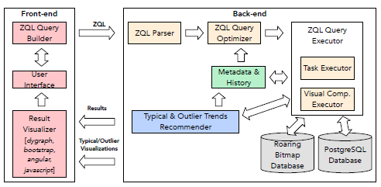
3.1 Zenvisage Components
Front-end
Back-end
a lightweight web-client application that runs completely within a user’s browser.
consists of a ZQL compiler, a
parser, an optimizer, and a query executor, and is capable of processing any ZQL query.

Slide 11
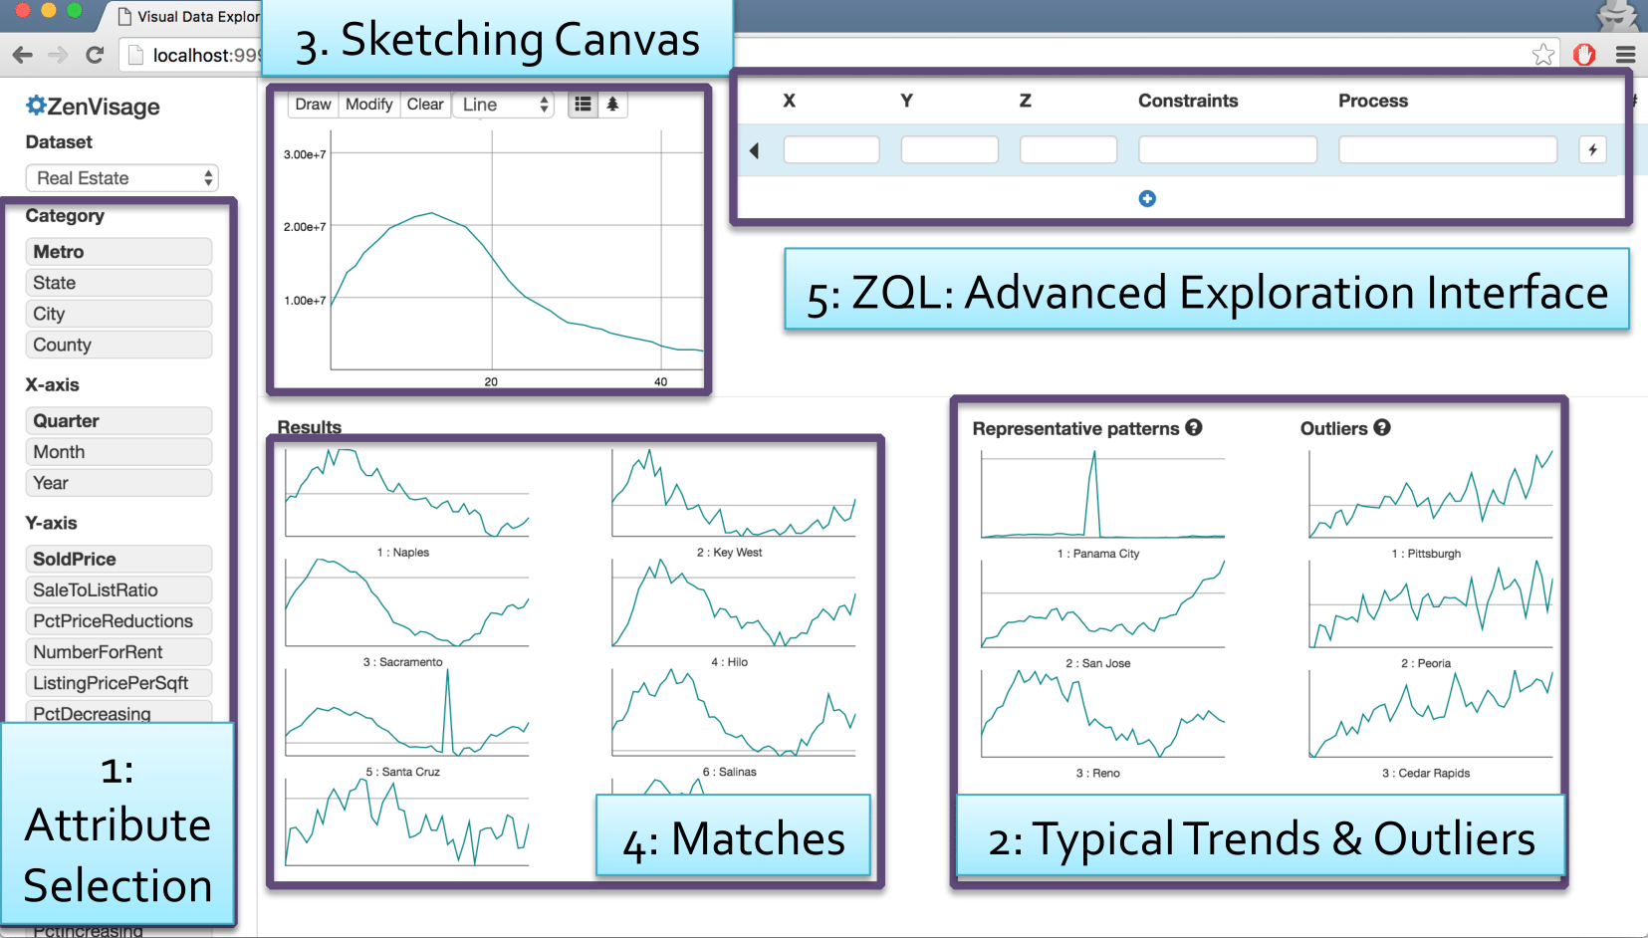
3.2 User Experience

Slide 12
3.3 Query Processing
In zenvisage, ZQL queries are automatically parsed and executed
by the back-end. The ZQL compiler translates ZQL queries into a combination of SQL queries to fetch the visualization collections and processing tasks to operate on them. We present a basic graph-based translation for ZQL and then provide several optimizations to the graph which reduce the overall runtime considerably.

Slide 13
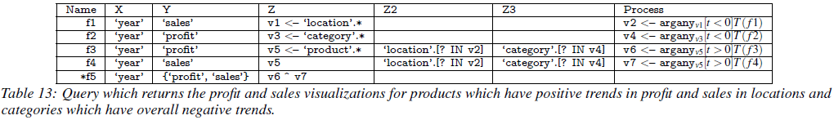

3.3.1 Basic Translation
Query Plan(DAG)
(i) Create a c-node or collection node for every collection of visualizations (including singleton collections).
(ii) Create a p-node or processor node for every optimization
(or process) in the Process column.
(iii) For each c-node, if any of its axis variables are derived as a result of a process, connect a directed edge from the corresponding p-node.
(iv) For each p-node, connect a directed edge from the c-node of each collection which appears in the process.

Slide 14
3.3.2 Query Execution
Execute Algorithm
1. Search for a node with either no parents or one whose parents have all been marked as done.
2. Run the corresponding task for that node and mark the node as done.
3. Repeat steps 1 and 2 until all nodes have been marked as done.
The generated SQL query has the following form:
SELECT X, Y FROM R WHERE Z=V AND (CONSTRAINTS) ORDER BY X.

Slide 15
3.3.3 Optimizations
Parallelization: multi-query optimization (MQO) f1、f2
Speculation:
Query Combination:
CacheAware Execution

Slide 16
Part 4
Query Language
Description
Examples
Expressiveness
High-level structure
Capabilities and Limitations

Slide 17
4.1 Description
We’ve developed a data exploration language called ZQL (Zenvisage
Query Language) enabling users to specify the desired visual insights.
Using a small number of ZQL lines (often < 2 lines),
users can specify desired trends, patterns, insights from visualizations

Slide 18
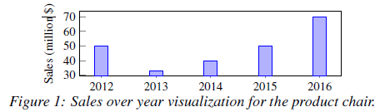
4.2 Examples
Different Types of Visualizations
1
bar charts, scatter plots or trend lines
Following Five Main Components
2
(i) the x-axis attribute,
(ii) the y-axis attribute,
(iii) the subset of data used,
(iv) the type of visualization (e.g., bar chart, scatter plot),
(v) the binning and aggregation functions for the x- and y- axes.

Slide 19



4.3 Expressiveness via ZQL
Visualization collections in ZQL
1
(i) X, (ii) Y, (iii) Z, and (iv) Viz.
Details for each of these columns
2
In short, the x axis (X) is the attribute year,
the y axis (Y) is the attribute sales, and
the subset of data (Z) is the product chair,
while the type of visualization is a bar chart (bar),
and the binning and aggregation functions indicate that the y axis is an aggregate (agg)— the sum of sales.

Slide 20

4.4 High-level structure of ZQL
General structure of ZQL queries
1
(i)the first column corresponds to an identifier for a visualization collection,
(ii)the second set of columns defines a visualization collection,
(iii)the last column corresponds to some operation on the visualization collection.
2
Identifiers and operations in ZQL
The Process column allows the user to operate on the defined collections of visualizations, applying high-level filtering, sorting, and comparison.
The Name column provides a way to label and combine specified collections of visualizations, so users may refer to them in the Process column.

Slide 21


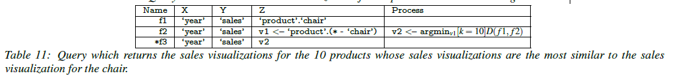
4.4.1 Sophisticate Situations

Slide 22

4.5 Capabilities and Limitations
Capabilities
ZQL’s primary goal is to support queries over visualizations—which are themselves aggregate group-by queries on data. Using these queries, ZQL can compose a collection of visualizations, filter them in various ways, compare them against benchmarks or against each other, and sort the results.
Limitations
(i) recursion;
(ii) any data modification;
(iii) non-foreign-key joins nor arbitrary nesting;
(iv) dimensionality reduction or other changes to the attributes;
(v) other forms of processing visualization collections not expressible via T,D or the black box;
(vi) statistical tests.

Slide 23
Part 5
What
Else
Reference
Evaluation

Slide 24

5.1 Reference
http://zenvisage.github.io/
Webpage
http://data-people.cs.illinois.edu/papers/zenvisage-vldb.pdf
http://data-people.cs.illinois.edu/papers/zenvisage-cidr.pdf
http://data-people.cs.illinois.edu/zenvisage.pdf
…
Report
主要问题三

Slide 25
5.2 Evaluation
1
Performance of optimization techniques
2
Usability and effectiveness via a user study
○ Fast and accurate: up to 100% faster than baseline, 30% more accurate results
○ Easy: Even non-programmers could learn a subset of ZQL and use it within a short period
○ Better: Unanimously, everyone preferred zenvisage over the baseline and wanted to
incorporate it into their current data analysis workflow

Slide 26
Thank You
Youxian Tao

